Slide 1
The Impact of Interdisciplinarity and Entity-based Knowledge Fusion Features on the Clinical Translation Intensity of COVID-19 Papers
Joint Workshop of the 4th Extraction and Evaluation of Knowledge Entities from Scientific Documents (EEKE2023)
and the 3rd AI + Informetrics (AII2023)
Shuang Chen
School of Health Management
China Medical University
shuangchen1212@163.com
Chunli Liu*
Library, China Medical University
liuchunliliangxu@163.com
Corresponding author

Slide 2


1 Introduction
Biomedical research
Clinical translation：related to the input/return of biomedical research.
Interdisciplinary research：the main mode of modern biomedical research.
Biological entity features： biological entity’s characteristics were more important than MeSH terms in predicting clinical translation (Li X, Tang XL, 2022).
Relationship between interdisciplinarity, entity-based knowledge fusion features and clinical translation intensity
The former is a coarser measure of the interdisciplinary characteristics of the paper based on the reference of the paper.
The latter is a measure of the cross-fusion characteristics of the knowledge units in the paper based on a finer granularity.
objectives
1) to measure the clinical translation intensity of COVID-19 articles published from late 2019 to 2021.
2) to measure the correlation between clinical translation intensity indicators, interdisciplinary indicators, and entity-based knowledge fusion features.
3) to test the impact of reference-based interdisciplinary indicators and the entity-based knowledge fusion features on the intensity of clinical translation of COVID-19 papers.
Li, X., & Tang, X. 2021. Characterizing interdisciplinarity in drug research: A translational science perspective. Journal of Informetrics. 101216, https://doi.org/10.1016/j.joi.2021.101216

Slide 3



2 Related works
The measurement of clinical translation intensity
From the perspective of research area
From the perspective of MeSH terms
From the perspective of citing paper：citations in secondary documents/clinical guidelines/clinical trials
From the perspective of entities
Neural network models with multiple perspectives
Interdisciplinary and clinical translation
Diversity :Variety, Balance and Disparity
Coherence:density, intensity and Disparity
Entitymetrics and clinical translation
Mentions of knowledge entities in papers
Inter-entity co-occurrence network
Entity-citation-entity network
Content novelty of scientific papers
The relationship between entity characteristics and the impact of papers

Slide 4
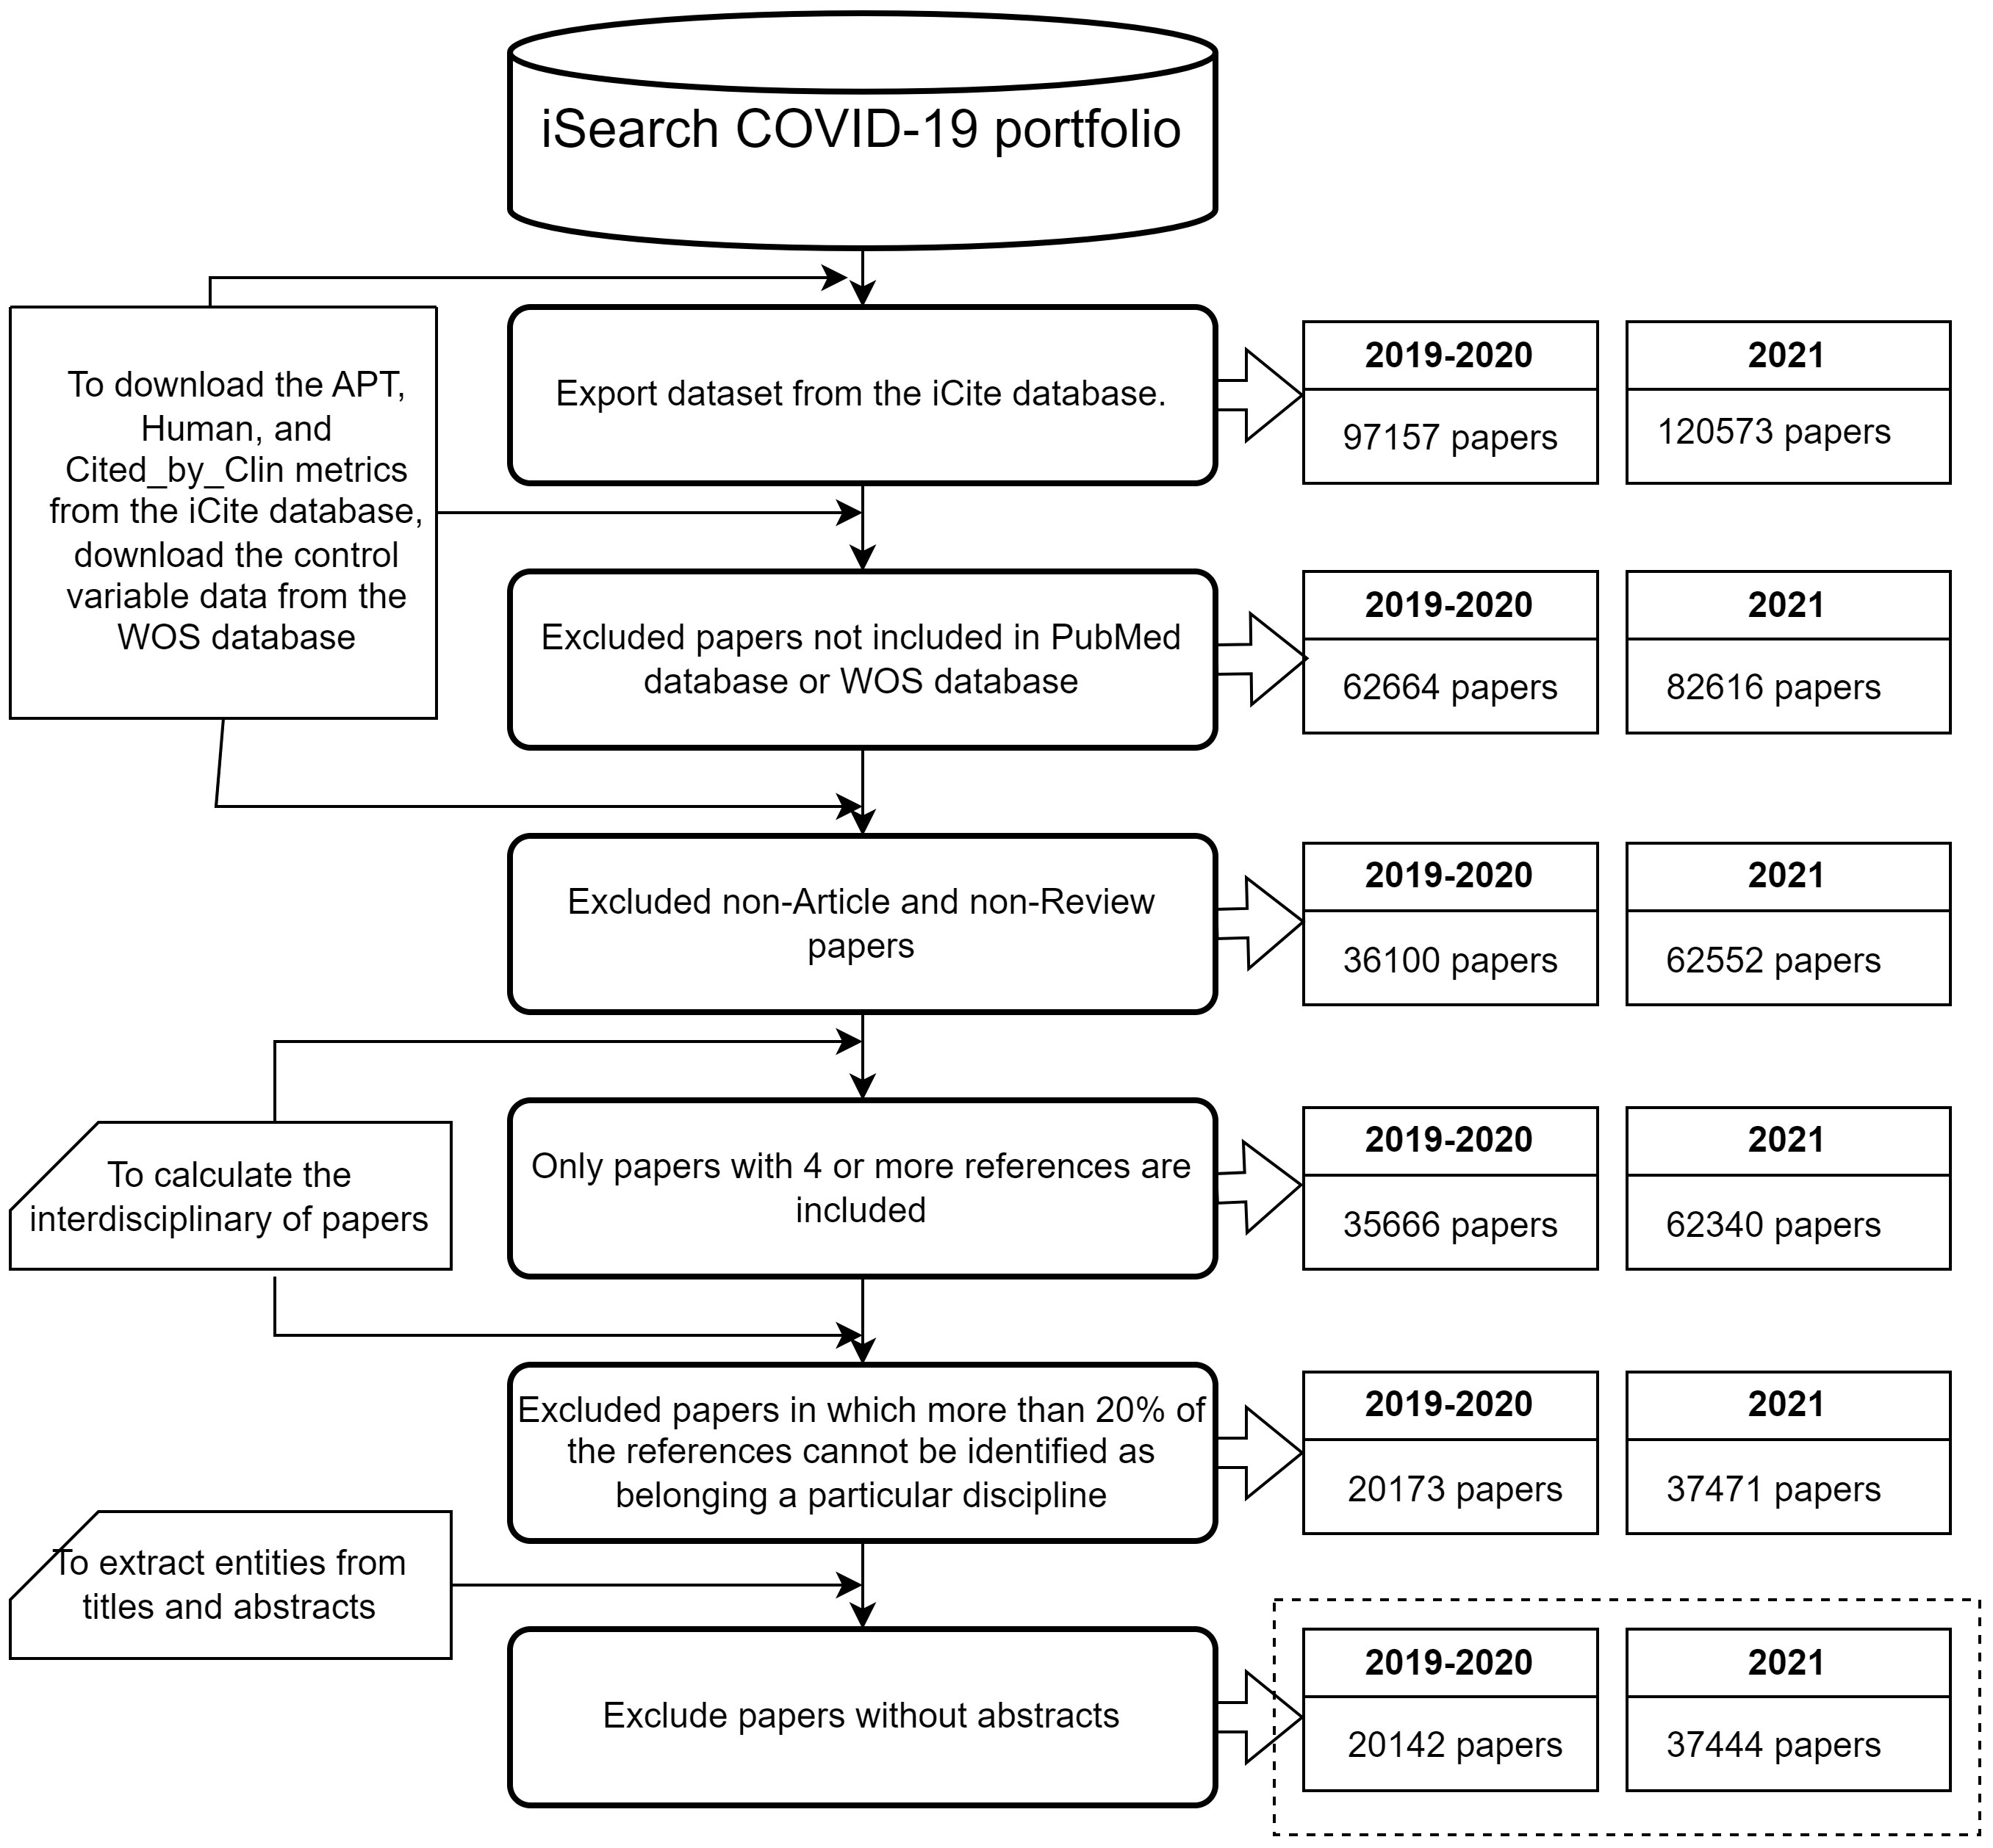
3 Methods
Data collection
On March 13, 2023, we exported a total of 217730 papers published in 2019-2021 from the iSearch COVID-19 portfolio
Screen Qualified data
Data Preprocessing
Clinical Translation Intensity
Interdisciplinary
Biological entity features
Data Analysis
Summary of APT, Human and Cited_by_Clin
The change of the APT, Human and Cited_by_Clin by month of publication from 2019 to 2021
Correlation between dependents and independents
Negative binomial regression models of clinical translation intensity
Inclusion and exclusion criteria

Slide 5
3 Methods——variables
Dependent variables
Independent variables
Control variables
Interdisciplinarity at reference level
Length of paper
Approximate potential to translate scores (APT)
RAO, True-Diversity, DIV*
Simpson, SHANNON
Disciplinary_Variety, Balance,DISP, NSUB
Number of references
Human
Variety and Balance at the entity level
Number of funds
CellLine，Chemical，Disease，Gene，Mutation，Species
Entity_Variety
R_Ce, R_Ch, R_Di, R_Ge, R_Mu, R_Sp
Cited_by_Clin
Length of Title
Popularity at the entity level
Number of authors
Ce_10, Ch_10, Di_10, Ge_10, Mu_10, Sp_10
Ce_1, Ch_1, Di_1, Ge_1, Mu_1, Sp_1
Importance at the entity level
Clinical paper
Betweenness centrality
Closeness centrality
Eigenvector centrality
PageRank
English Language
Novelty at the entity level
Primary research article
Novelty score

Slide 6
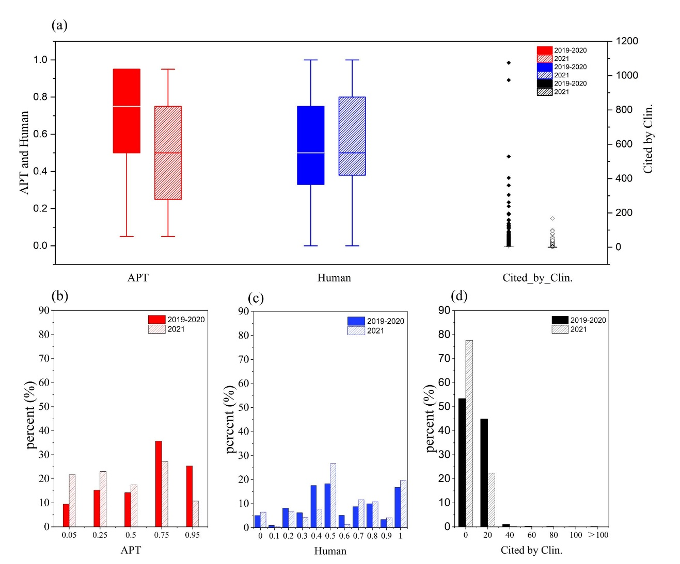
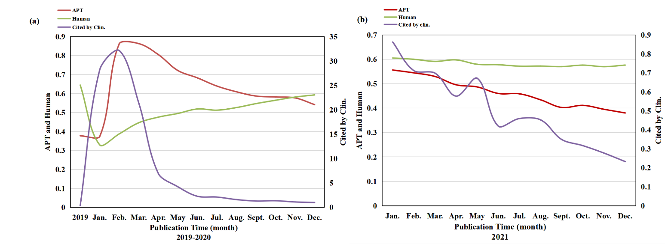
4 Results——Summary of APT, Human and Cited_by_Clin
Figure 3. The change of the APT, Human and Cited_by_Clin by month of publication from 2019 to 2021
Figure 2. Distribution of APT, Human and Cited_by_Clin

Slide 7
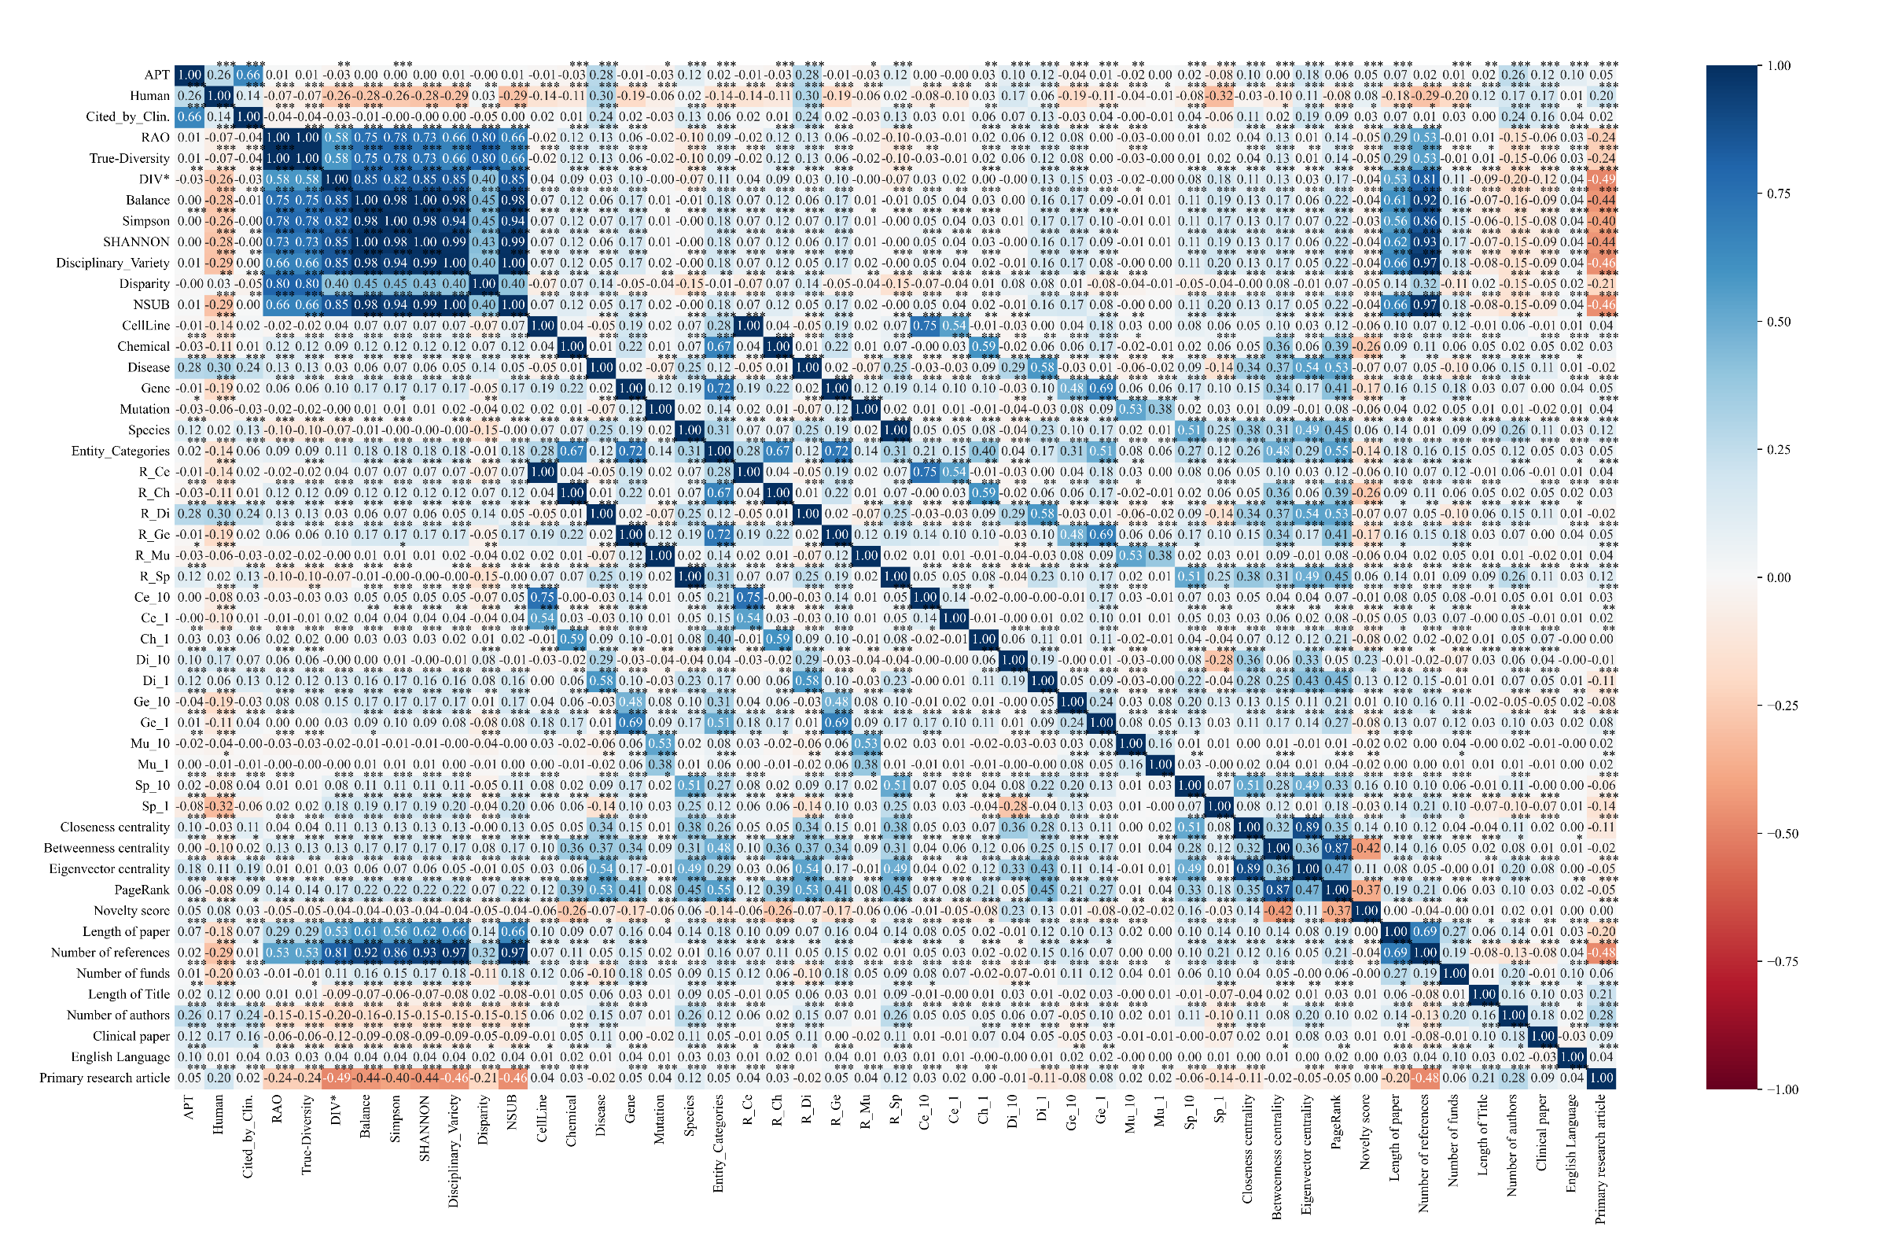
4 Results——Correlation between dependents and independents
2019-2020

Slide 8
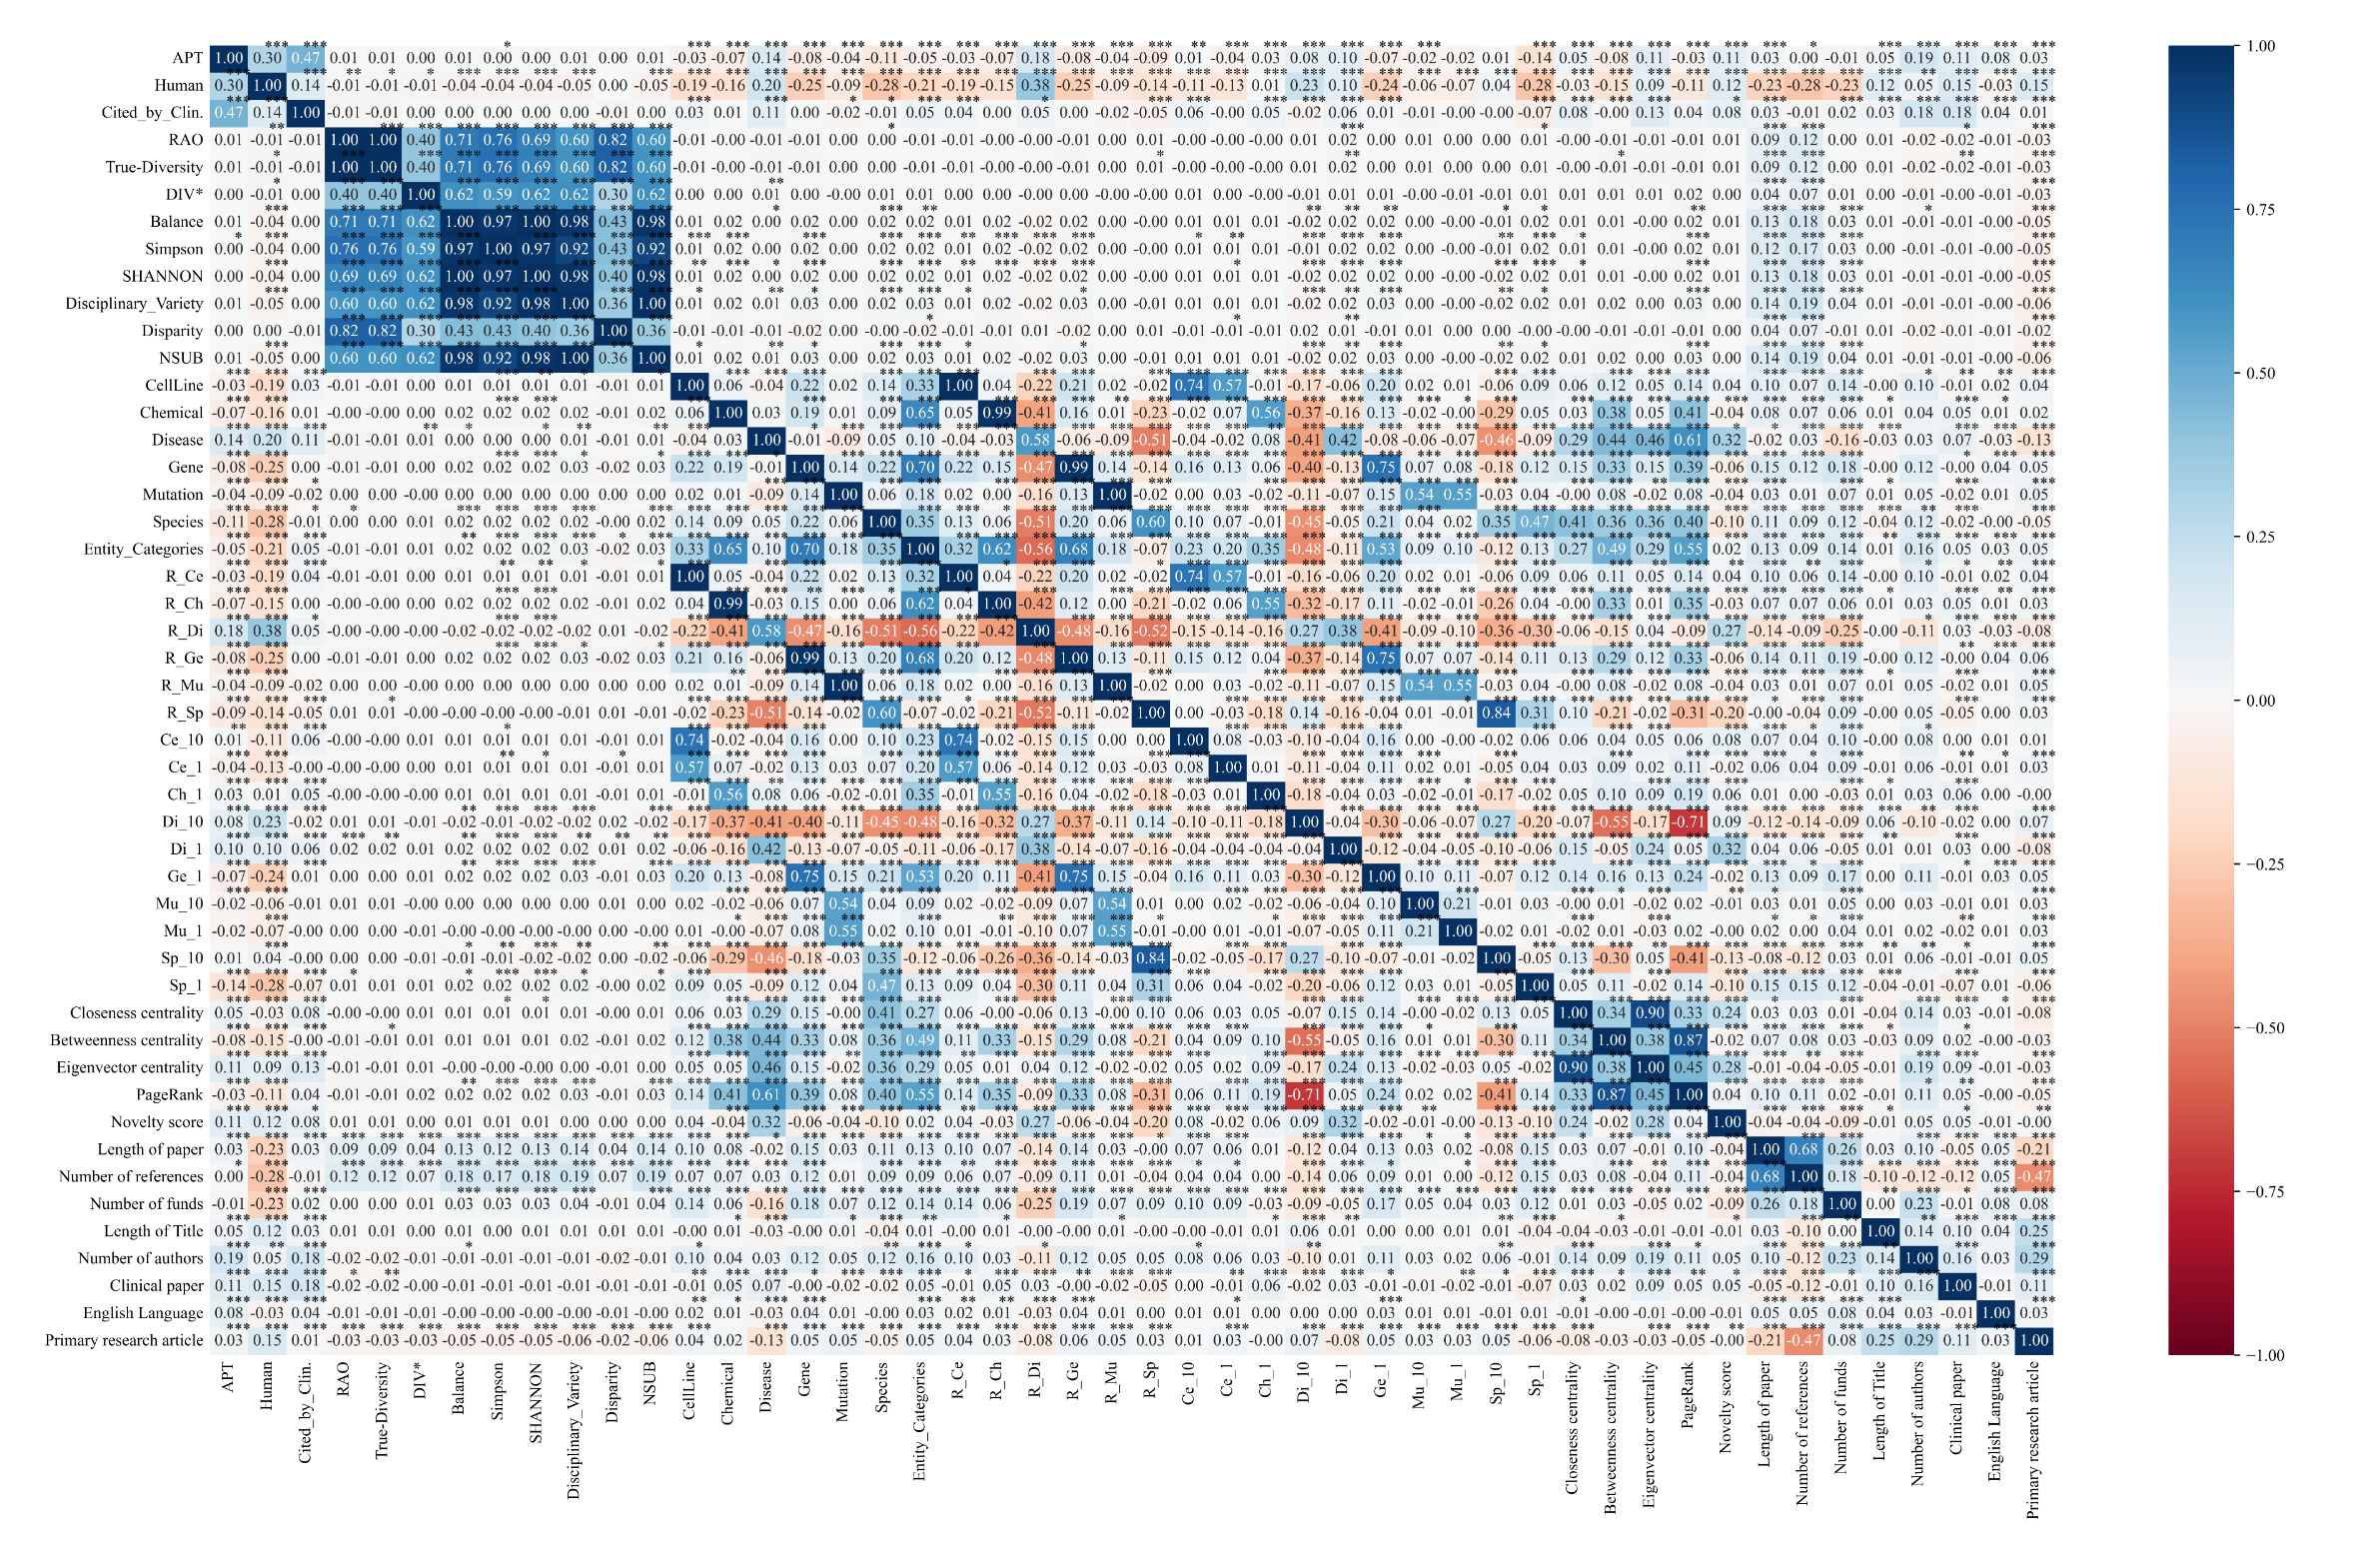
4 Results——Correlation between dependents and independents
2021

Slide 9
4 Results——Statistics analysis
Model： Negative Binomial Regression three clinical translation indicators （ 2019-2020 and 2021 ）
M1：control variables & APT, Human, Cited by Clin.（base model）
M2：interdisciplinarity & APT, Human, Cited by Clin.
M3：entity variety and balance & APT, Human, Cited by Clin.
M4：entity level popularity & APT, Human, Cited by Clin.
M5：entity level importance & APT, Human, Cited by Clin.
M6：entity level novelty & APT, Human, Cited by Clin.
M7：all variables & APT, Human, Cited by Clin.

Slide 10
5 Discussion
Interdisciplinary Features
2019-2020
No significant influence on APT
True-Diversity and SHANNON have significant influence on Human.
Rao, True-Diversity and Simpson have significant effects on Cited_by_Clin.
2021
No significant influence on APT, Human and Cited_by_Clin
The clinical impact of a paper is more related to whether the main content of the paper is biased toward "human beings" or whether it is recognized and accepted by the clinical industry or the pharmaceutical industry.
The diversity and balance, the popularity, the importance, and the novelty of the paper have a certain impact on the clinical translation intensity of the paper. Most of the test results suggest that these entity characteristics have a greater impact on the clinical translation intensity of the 2021 papers than on that of the 2019-2020 papers.
Fine-Grained Knowledge Fusion Indicators
entity variety and balance
entity level popularity
entity level importance
entity level novelty

Slide 11
5 Discussion
Entity_Variety & Entity_Balance
2019-2020
Entity variety had no effect on clinical translation intensity.
The entity proportion is also excluded because of collinearity.
2021
Entity variety had a positive effect on APT, Human, and Cited_by_Clin
The proportion of 3-4 types of entities had a significant positive or negative impact on the clinical translation strength of the papers.
Popularity of the Paper
2019-2020
6-7 hot or sub-hot entities that significantly affect the clinical translation intensity of the papers, but only hot disease entities and sub-hot disease entities affect the APT of the papers.
2021
More types of hot or sub-hot entities that affect the clinical translation intensity of papers in 2021, reaching 7-10.
More sub-hot entity types that have an impact on the clinical translation of the paper, reaching 4-5 types,.
The average number of hot entity types that have an impact is 1-3.

Slide 12
5 Discussion
Entity Importance
At least 3-4 indicators that significantly affect APT, Human, Cited_by_Clin, except that only the eigenvector centrality affects the Human of the 2019-2020 papers.
Entity Novelty
Entity novelty has always had a significant positive effect on the clinical translation intensity of papers, and the influence coefficient approximately doubled over time, except that the novelty of papers in 2019-2020 is not related to APT.

Slide 13
6 Conclusion
We measured the clinical translation intensity of COVID-19 papers published in 2019-2021 and examined the impact of interdisciplinary characteristics and entity features on clinical translation intensity.
Traditional interdisciplinary characteristics are not good at influencing the clinical translation strength of papers.
Based on the biological entity characteristics of the paper, we sorted out four dimensions of knowledge fusion indicators, which can be used to evaluate the variety and balance, popularity, importance, and novelty of the paper.
Most of these indicators have a significant promoting or hindering effect on the clinical impact of the paper and deserve further exploration and verification.

Slide 14
Thank you for your attention！
Joint Workshop of the 4th Extraction and Evaluation of Knowledge Entities from Scientific Documents (EEKE2023) and the 3rd AI + Informetrics (AII2023)
Shuang Chen
School of Health Management
China Medical University
shuangchen1212@163.com
Chunli Liu*
Library, China Medical University
liuchunliliangxu@163.com
Corresponding author

